Slide 1

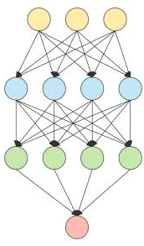
Sentence-State LSTM for Text Representation
Presenter: Fatemeh Sadat Rezvaninejad
97722086

Slide 2
01
03
INTRODUCTION
02
MODEL AND DATASET
SENTENCE-STATE LSTM
04
05
RESULTS
AUGMENTATION

Slide 3
INTRODUCTION
LSTM , BILSTM limitations:
Sequential Structure
Non-parallel computation
Time consumption

Slide 4

SENTENCE-STATE LSTM
a hidden vector hi for each input word wi, and a global sentence-level hidden vector g.

Slide 5


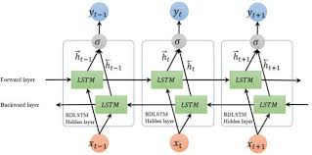
A single hidden vector representation g of the whole input sentence can be obtained using the final state values of the two LSTM components

Slide 6
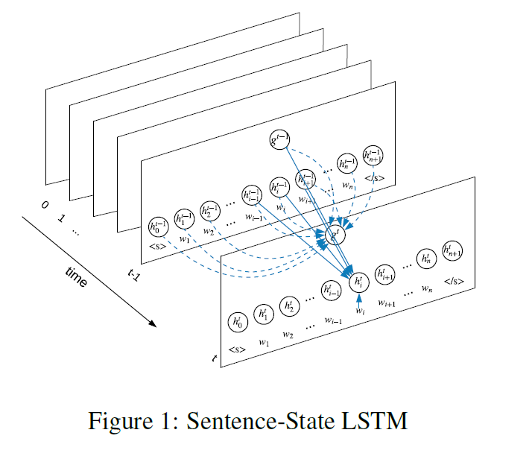


Slide 7

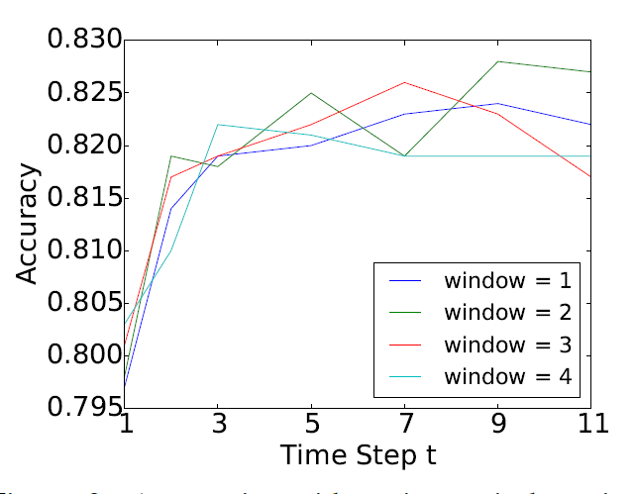
SST-2
Movie Review
Accuracy | Time(s) | Model
82.36 | 63 | Without<s>,</s>
82.64 | 65 | With<s>,</s>

Slide 8
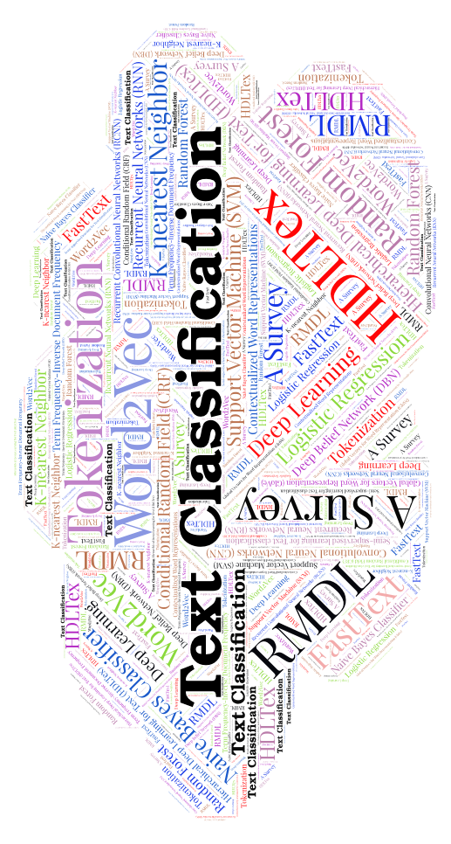
EDA: Easy Data Augmentation Techniques for Boosting Performance on Text Classification Tasks

Slide 9

Having a large dataset is crucial for performance.
Benefits of Data Augmentation
● Technique to increase the amount of relevant data
● More data usually means better accuracy
● Very useful when you have small training datasets
● Reducing overfitting
● More robust models

Slide 10

TEXT
In natural language processing (NLP) field, it is hard to augmenting text due to high complexity of language

Slide 11
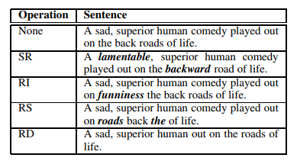
EDA
Synonym Replacement(SR)
Random Insertion(RI)
Random Swap(RS)
Random Deletion(RD)
Number of words that should change
n=αl

Slide 12
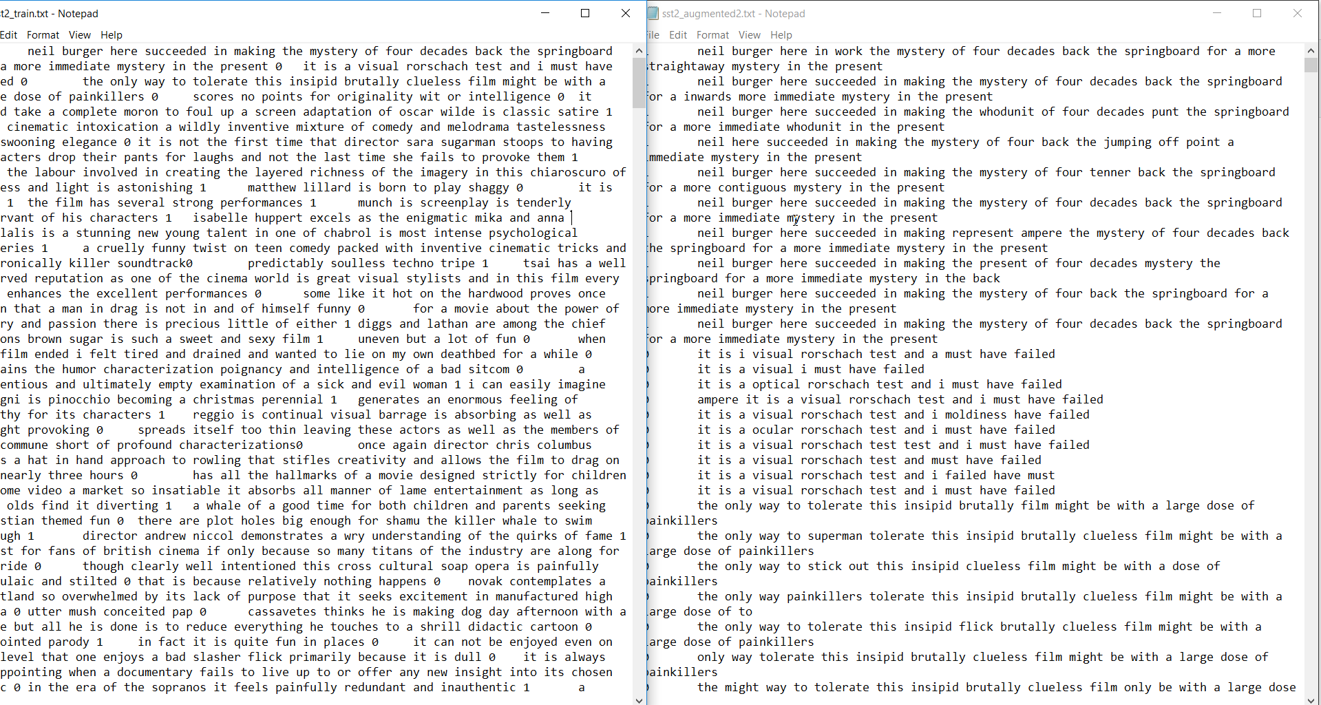
Random deletion+ Synonym replacement
Random not+ opposite
My Approach
n_{aug} | α | N_{train}
16 | 0.05 | 500
8 | 0.05 | 2000

Slide 13
Paper results
#Param | Accuracy | Time(s) | Model
5977K | 80.72 | 67 | LSTM
7059K | 81.73 | 106 | BiLSTM
8768K | 82.64 | 65 | S-LSTM
Results
My results
Accuracy | Time(s) | Model
79 | 115 | BiLSTM
80.7 | 107 | S-LSTM
results
Training Set size 500 2000 |  | Model
79 | 78.2 | S-LSTM
80.7 | 81 | +eda

Slide 14
SUMMARY

Slide 15

Wei, J.W. and Zou, K., 2019. Eda: Easy data augmentation techniques for boosting performance on text classification tasks. arXiv preprint arXiv:1901.11196.
Zhang, Yue, Qi Liu, and Linfeng Song. "Sentence-state lstm for text representation." arXiv preprint arXiv:1805.02474 (2018).https://towardsdatascience.com/machinex-image-data-augmentation-using-keras-b459ef87cd22

Slide 16

THANKS!
Any questions?
Rezvaninejad_f@comp.iust.ac.ircomp.iust.ac.ir

Slide 17
